Slide 1
Employee’s information system
-Kelompok BlackHole-
Fila Brilyanti Utami
Astrid Rifa
Aafiudin
Amanda Putri Septiani

Slide 2
problem
Difficult to manage employee’s data in the company with the manual way
Difficult to manage employee’s salary according to the employee’s class
Difficult to manage employee’s daily presence

Slide 3
Feasibility and planning
Client : Company
Scope : Human Resource Information System
Advantages : Easy to manage, Decrease the risk of missing data and error, Make it easier for counting employee’s salary
Risks :
Take a long time because the number of developer
Difficult to make error handling
Need the expert to run the program in the company
Alternative :
Use the timetable
Give a simple training to the operator in the company (client)

Slide 4
System requirements
System Requirements
Process-Oriented :
- System can add new employee
- System can detect the input from user
Information-Oriented :
- System has employee data
Operational :
- System should be operated using in all web browser
- System is easy to use.

Slide 5
System requirements
Performance :
- The system has the ability to store data
- System responds in + 0.5 second
Security :
- Only users who are logged in can be absent
- Only Secretary who can recapitalize absent

Slide 6
TECHNICAL FEASIBILITY
Conventional / Traditional system sometimes can be manipulated for personal gain.
Java™ Programming Language based.
NIP as special ID for input.
All logs are recorded in application.
Salary are calculated using Rank, Work, Employee Benefits, and Penalty by application in the end of the month.

Slide 7
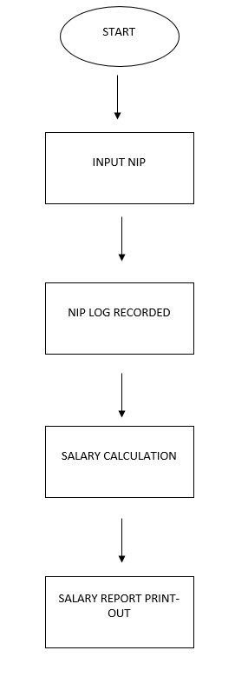

Slide 8
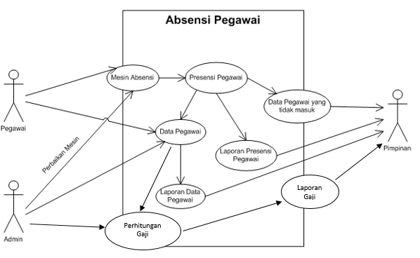
Use case diagram

Slide 9
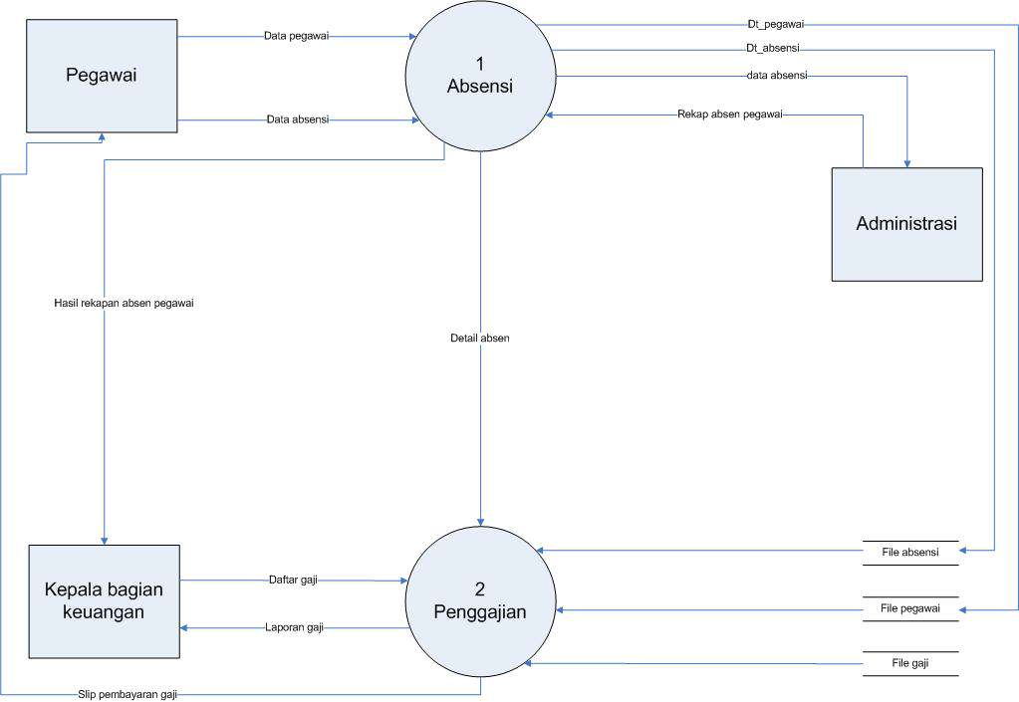
DFD

Slide 10
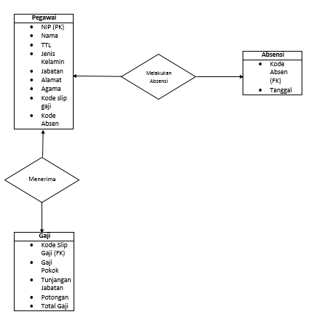
ERD

Slide 11
THANK you

